Slide 1
What is a tumor marker?
A tumor marker is a substance present in or produced by a tumor ( benign or malignant )
That can be used to differentiate a tumor from normal tissue

Slide 2
Characteristics of an Ideal Tumor Markers
Should be highly specific ( negative in all negative cases) (diagnosis)
Should be highly sensitive ( positive in all positive cases).(diagnosis)
Should provide a lead – time over clinical diagnosis … (Screening)
The levels of the marker should correlate with the tumor burden.(prognosis)
It is accurately reflecting any tumor progression or regression (monitoring)
Procedure of estimation of the marker should be reliable
The test used for detection should be relatively cheap

Slide 3
Applications of Tumor Markers
1- Diagnosis ( D) : to help to establish the diagnosis
2- Screening (S) : to identify patients with early cancer before appearance of clinical manifestations
3- Prognosis (P) : to assess the aggressiveness
4- Monitoring (M) : follow up of regression or progression
A- Evaluate the Response to Treatment ( RT)
B- Detection pf Recurrence (R)
5- Determination of Risk : i.e. in genetically predisposed ….

Slide 4
Who needs to be screened
1. Person have had cancer in the past
2. Have two or more first-degree relatives who have had cancer
3. Have certain gene mutations that have been linked to cancer
4. Environmental exposure

Slide 5
To increase sensitivity & specificity of tumor markers
A- Combination of multiple tumor markers
B-Combination of multiple tumor markers with other procedures
e.g. Combination of Carbohydrate Antigen 125 (CA 125) with ultrasonography for early detection of ovarian malignancy

Slide 6
Monitoring of disease , Response of Treatment & Detection of Recurrence
Markers usually increase with progressive disease , decrease with remission & change significantly with stable disease .
After treatment ( surgical resection , radiation or chemotherapy ) ,tumor marker routinely followed serially ( to monitor the response to treatment & recurrence )
It is desirable to monitor the patient using a highly sensitive tumor marker detect recurrence as early as possible
so, rising tumor marker levels may detect recurrence of disease before or radiological evidence of disease is apparent ( biochemical recurrence)

Slide 7
Factors that affect serum concentration of tumor markers
False positive results occur with
Inflammatory conditions
Benign conditions
Presence of liver disease : causes disturbances in metabolism of some tumor markers
Disturbances of renal function : affects levels of some tumor markers
As a consequence of different physiological conditions : as in preg… affect BHCG , AFP…)

Slide 8
Factors that affect serum concentration of tumor markers
False negative results occur with
Insufficient blood circulation in the tumor
Production of autoantibodies against the marker
Rapid degradation & clearance of the marker

Slide 9
good tumor marker should
1- It should be highly sensitive
2- It should be highly specific
3- 100% accuracy in differentiating between healthy individual and tumor patient
4- should be able to differentiate between neoplastic and non-neoplastic disease and show positive correlation with tumor volume and extent
5- It should predict early recurrence and have prognostic value
6-It levels should be preceding the neoplastic process , so that it should be useful for screening early cancer

Slide 10
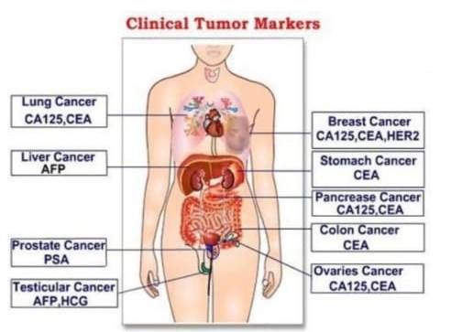

Slide 11
Potential uses
Screening in general population
Differential diagnosis of symptomatic patients
Clinical staging of cancer
Estimating tumor volume
As a prognostic indicator for disease progression
Evaluating the success of treatment
Detecting the recurrence of cancer
Monitoring response to therapy

Slide 12
THANK YOU

